Slide 1
Development of a prioritization tool to translate MCH data into strategic directions
James A. Gaudino, Jr. MD, MS, MPH, FACPM
Sarah-Truclinh Tran, MPH
Sandy Johnson, PhD
Mindy Stadtlander, MPH
Jessica Guernsey, MPH
Multnomah County Health Department

Slide 2
Notes:
Public health planners often have to make sense of the overwhelming volume, limitations, and gaps in surveillance data in order to prioritize maternal and child health (MCH) problems in communities. Yet few approaches to guide priority-setting are available.

Slide 3
Background
2010-2011: Leadership at the Multnomah County Health Department went through a strategic planning process to improve the coordination of maternal, infant, and child health (MCH) programs and services in Multnomah County, Oregon.
Notes:
The strategic plan would provide the foundation for improving the coordination of MCH programs and services at the Health Department, and for identifying key external partners to engage in the work.

Slide 4
Goal
Epidemiology Unit asked to compile an “MCH data profile” for Multnomah County.
Needed to highlight current and emerging MCH problems.

Slide 5
Selected MCH Health and Wellbeing Measures
USPHS Healthy People 2010 and 2020 Objectives
(as data available & from hundreds of objectives across topic areas, not just the Maternal, Infant and Child Health objectives)
Few other measures of interest
Many by (as relevant) :
Time (trends across years)
Age groups
Race/ethnicity
Socioeconomic status: using Oregon Health Plan (OHP) as proxy.
Geographic location

Slide 6
“Lenses” for Viewing MCH Data and Identifying Gaps
Social determinants of health
Disparities in health and health equity
Life-course perspective

Slide 7
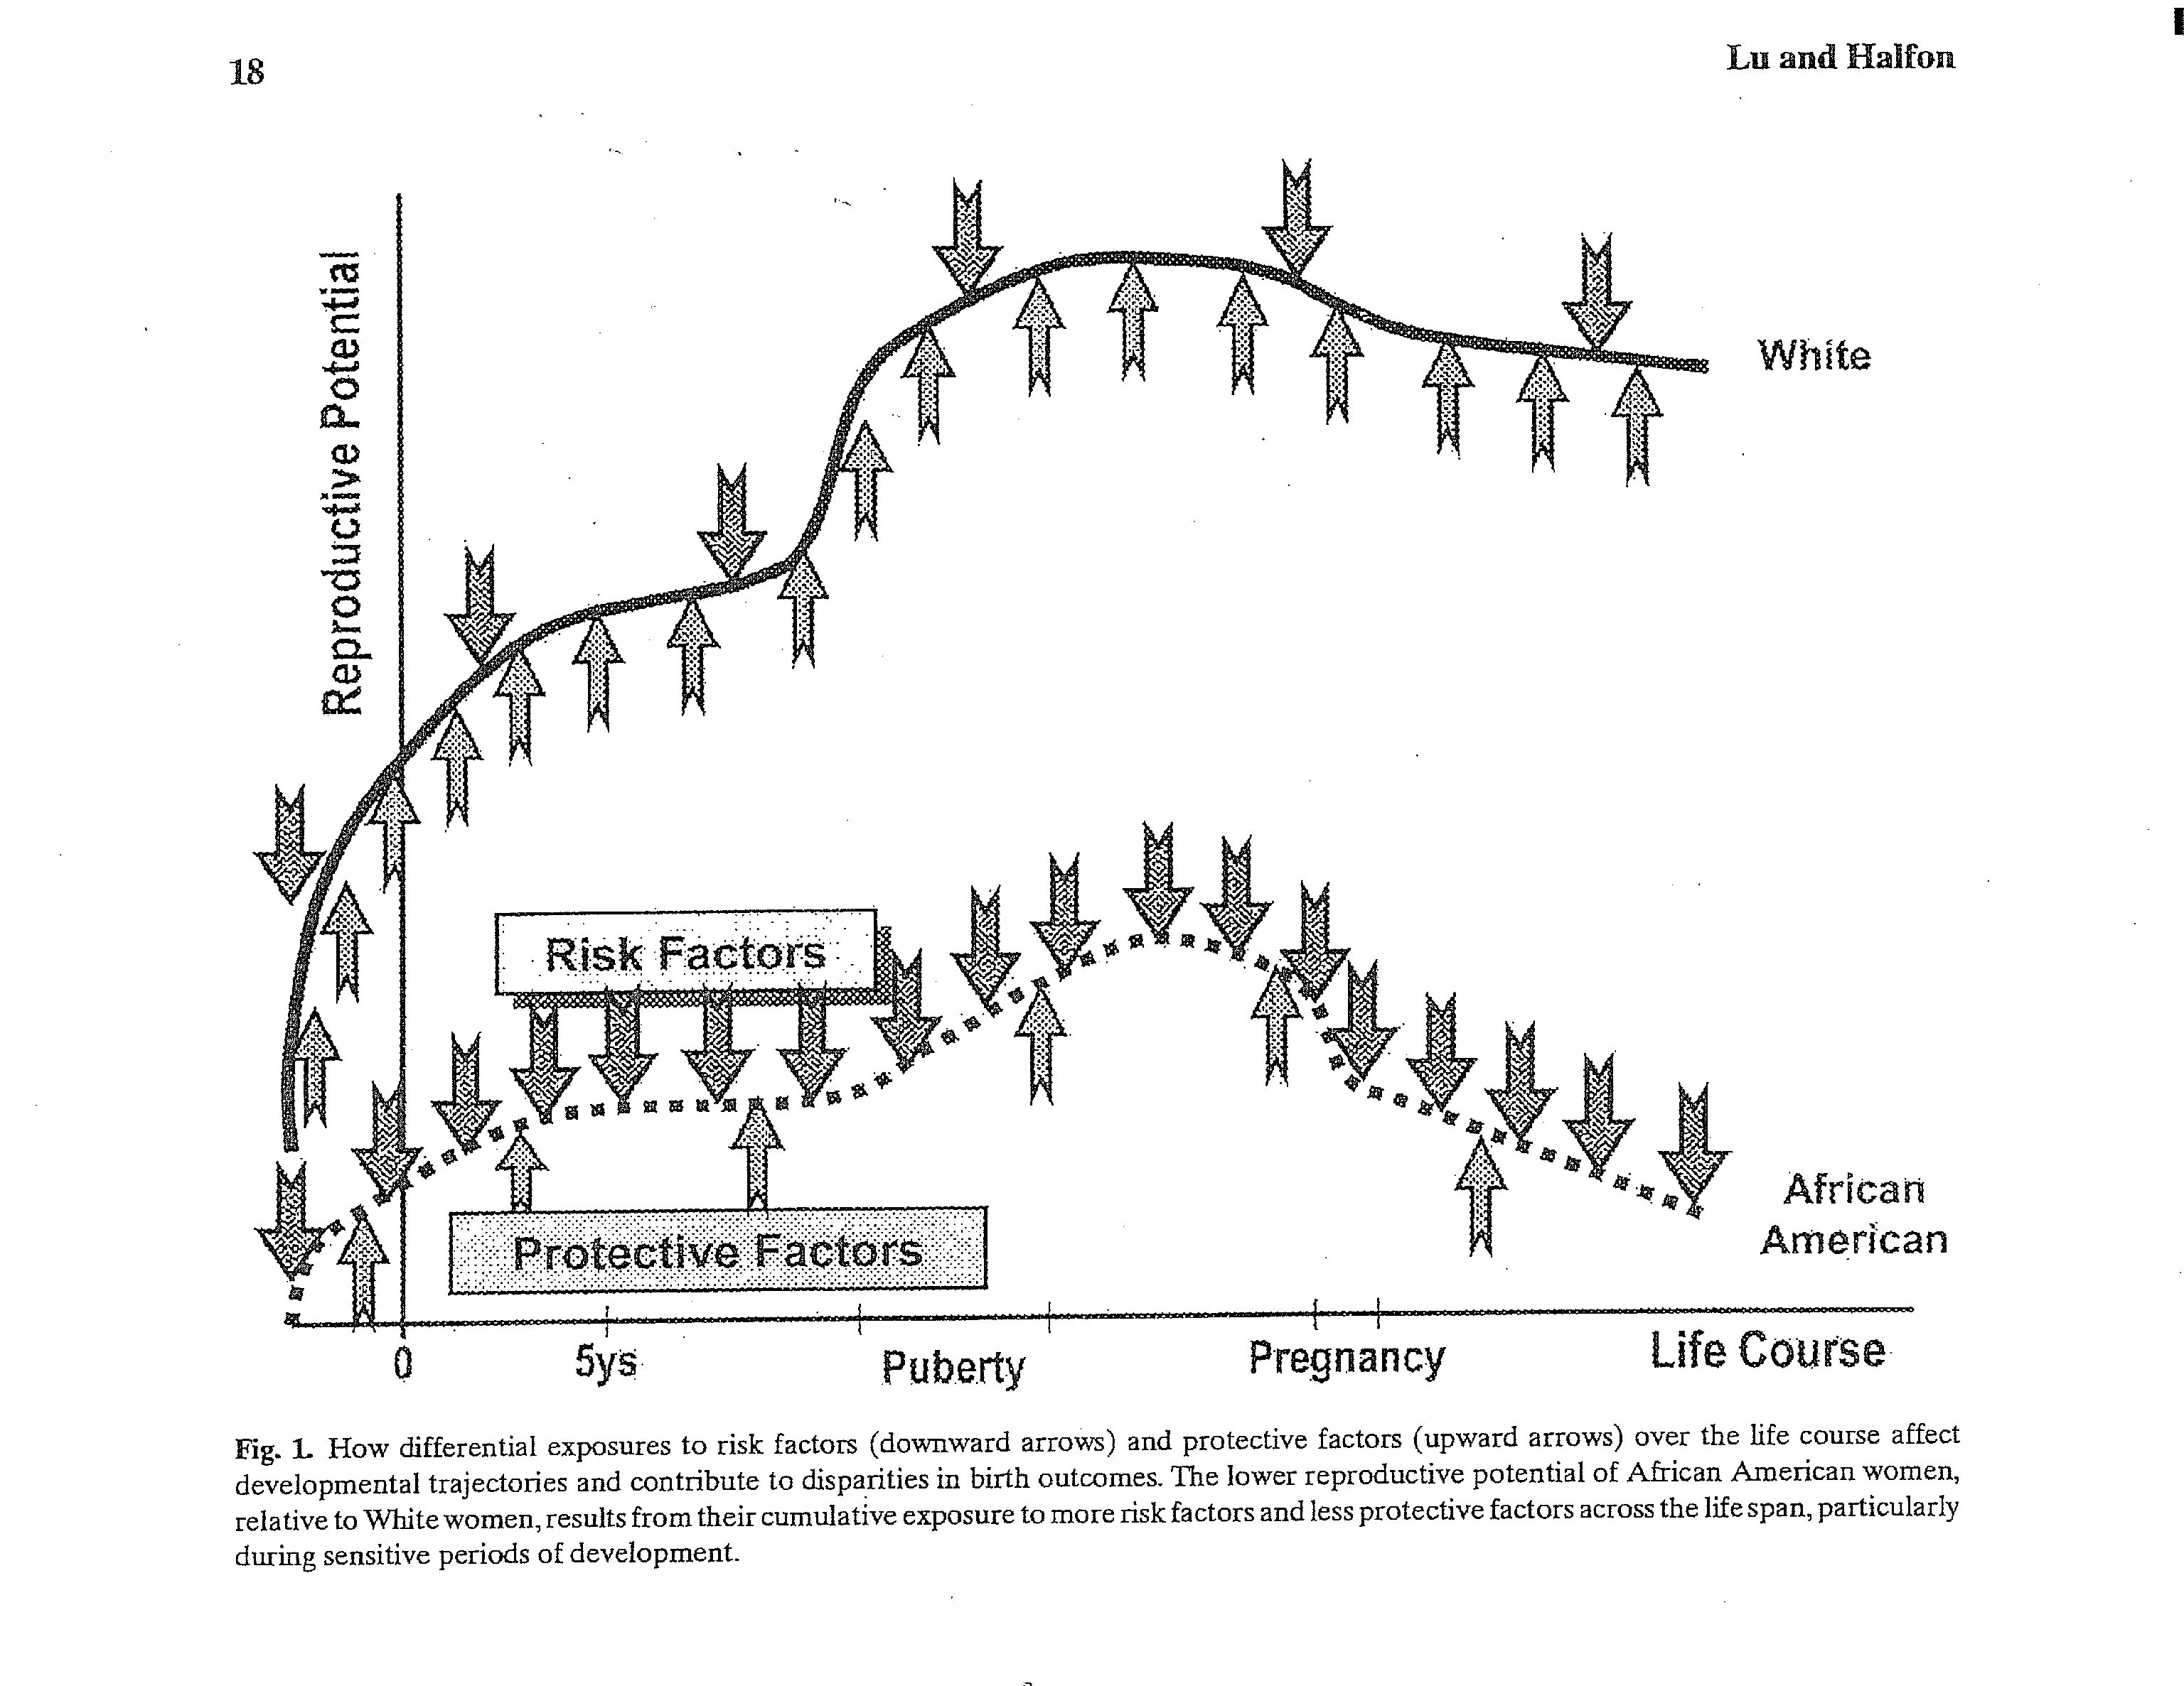
A Model for How Differential MCH Risk and Protective Factors Might Affect Health Over the Life Course
Source: Lu M & Halfon N, Racial and Ethnic Disparities in Birth Outcome: A Life-Course Perspective, MCHJ 2003;7:13-30.

Slide 9
MCH Indicators
GROUP | MEASURE* | DATA GAPS
FAMILY PLANNING | Unintended pregnancies | Emerg. contraception use/ measures in family planning clinic & school-based health center/ special populations (ex: homeless, immigrant/refugees)
 | Birth-to-pregnancy spacing <18 months
 | Teen pregnancy; repeat teen births
PRECONCEPTION HEALTH | Unhealthy pre-pregnancy BMI | Physical activity, nutritional status/ mental health/ oral health/ parenting skills & support
 | Folic acid/multivitamin intake
 | Substance use before pregnancy
PERINATAL HEALTH & BEHAVIORS | Substance use during pregnancy | Content and adequacy of prenatal care/ maternal nutritional status/ illicit drug use/ hospitalizations/ postpartum substance use or relapse/ physical activity/ social support
 | Early and adequate prenatal care
 | Recommended weight gain during preg.
 | Depression (during and after pregnancy)
MORBIDITY & MORTALITY | Infant mortality | Maternal hospitalizations & mortality/ postpartum health visits/ perinatal hospitalizations & outpatient visits
 | Low birth weight (<2,500g)
 | NICU admittance
 | Preterm births (<37wks)
 | Low-risk Cesarean deliveries
INFANT CARE | Infants put to sleep on their backs | Infant hospitalizations, ER & outpatient visits/ birth defects/ infant growth & nutritional status/ oral health/ parenting skills & support
 | Postpartum smoking relapse
 | Breastfeeding duration
CHILD GROWTH & DEVELOPMENT | Immunizations | Child hospitalization, ER visits/ development status/ oral health/ asthma/ obesity
 | Abuse and neglect (confirmed cases)
HOME, FAMILY, & COMMUNITY | Intimate partner violence among adults | Childcare access & quality/ paternal & family supports/ violence/ screen time/ housing/ access to healthy foods, safe neighborhoods/ indoor, outdoor env’t health
 | Smoking in household
 | Father un-involvement**
Notes:
[JIM: CLICK MOUSE FOR EACH GROUP TO APPEAR]

Slide 10
Births by pregnancy intention, by maternal race/ethnicity, Multnomah County
Source: PRAMS 2005-07

Slide 11
Folic acid intake before pregnancy among women who had a live birth, Multnomah County
Source: PRAMS 2005-07

Slide 12
Intimate partner violence prevalence among women >18 yrs with a live birth, Multnomah County
Source: PRAMS 2005-07

Slide 13
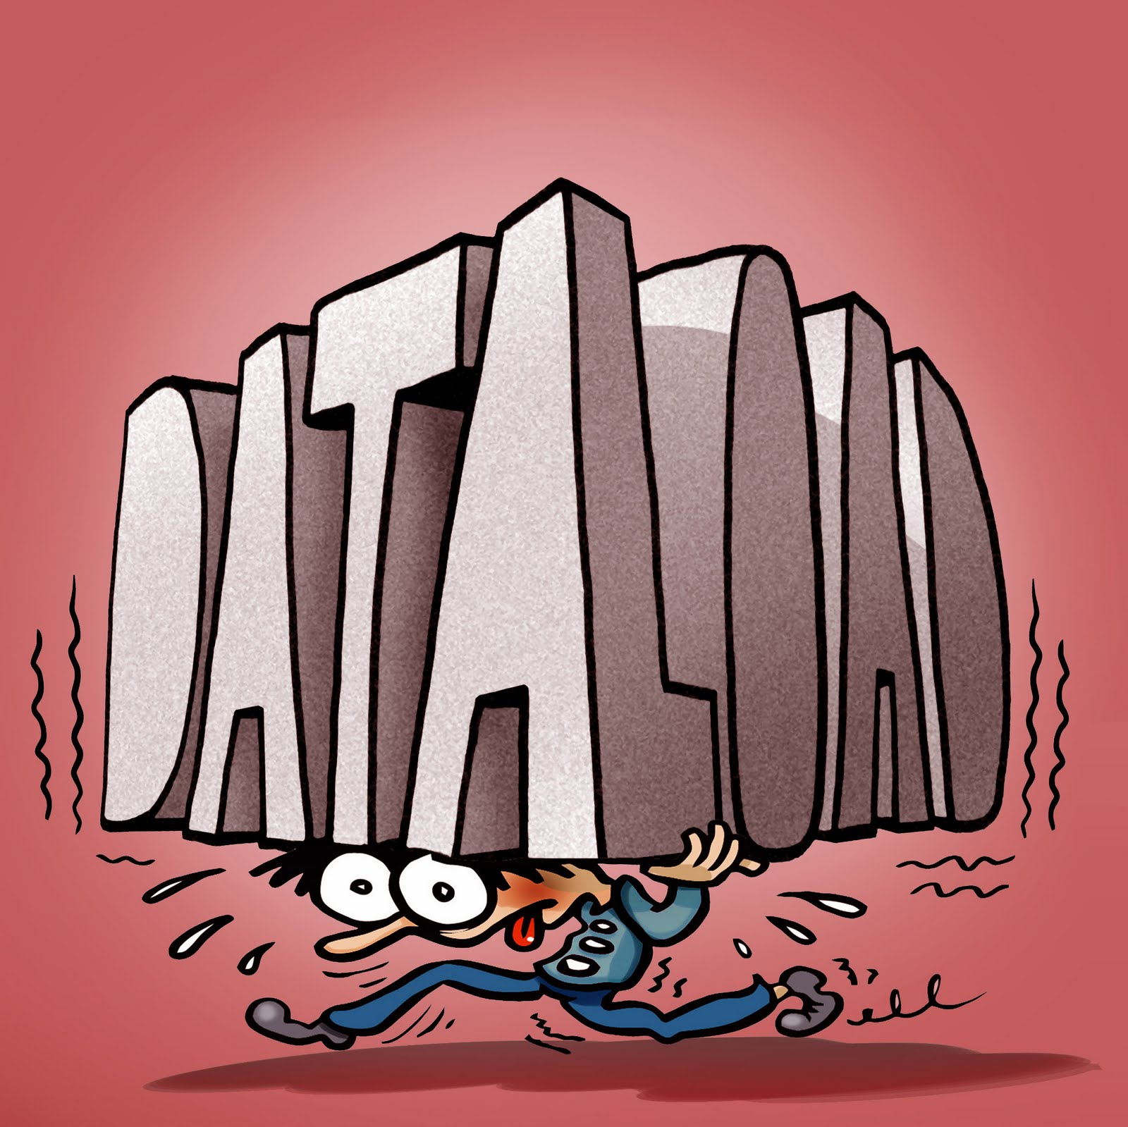
Notes:
Public health planners often have to make sense of the overwhelming volume, limitations, and gaps in surveillance data in order to prioritize maternal and child health (MCH) problems in communities. Yet few approaches to guide priority-setting are available.

Slide 14
Methods: Thirteen criteria considered
Disparities by race/ethnicity
Disparities by OHP status
Disparities by maternal age
Trends worsening
Unmet Healthy People target
Large population affected
Severe consequences
Problem is an upstream factor
Community lacks capacity to address the problem
Community concern (e.g., political will exists)
Amenable to intervention
Affects high-risk groups (e.g. groups affected by multiple risk factors)
Affects the Health Department’s target population (those enrolled in OHP or have barriers to accessing care).
Notes:
To allow a variety of perspectives to be fully represented in the prioritization process, we developed a matrix that encourages consideration of all of the criteria in a balanced, rational way.
We originally came up with thirteen criteria. As a group, we narrowed the list down to six final criteria (Table 2) that we felt were most objective and that were guided by our agency’s mission, vision, and values, and our adopted health equity framework. (2, 3) These six criteria were presented to Leadership.

Slide 15
Methods
CRITERIA | VALUES
Disparities by Race/Ethnicity | 1: Relative Prevalence (RP) > 1.5
 | 0.5: RP= 1.2-1.49
 | 0: No significant disparities
Disparities by Oregon Health Plan^{α} (OHP) Enrollment Status | 1: RP > 1.5
 | 0.5: RP= 1.2-1.49
 | 0: None
Disparities by Maternal Age | 1: RP > 1.5
 | 0.5: RP= 1.2-1.49
 | 0: No significant disparities
Trends Worsening^{β} | 1: Worsening
 | 0.5: No improvement
 | 0: Getting better
Unmet Healthy People Goal | 1: Unmet HP goal
 | 0: Met
Large Population Affected | 1: Prevalence is higher than the state prevalence or is >10% of the at-risk population.
 | 0: No
Notes:
We used the following scoring for the final six criteria.

Slide 16
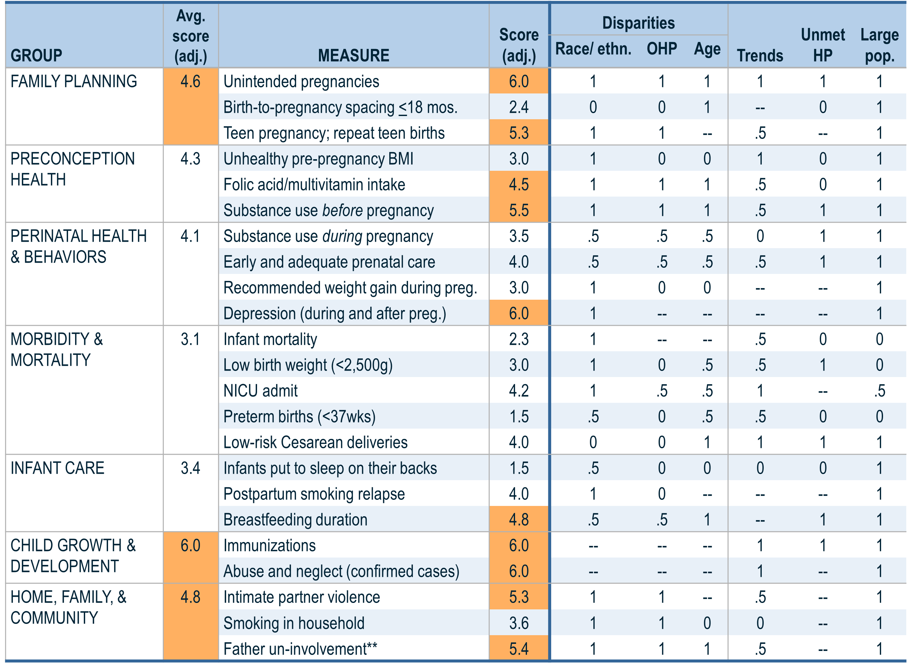
Notes:
This is what the final matrix looks like. Orange shades indicate scores 4.5 and higher.

Slide 17
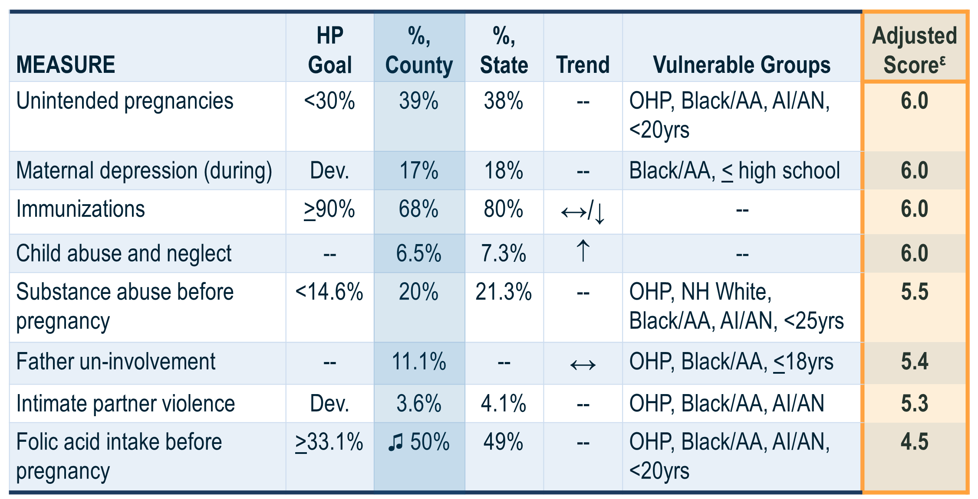
Results: Measures with Highest Scores
^{ε} Adjusted for missing information; scores are out of a possible 6.0.

Slide 18
Lessons Learned
Developed a simple and effective way to organize and summarize the data
Using a broad, life-course perspective helped our diverse group of decision-makers consider and identify priority MCH concerns
Scoring both the measures and life-course groups of measures helped decision-makers discuss specific areas and achieve consensus.
Though we did not use scores from the subjective criteria, priority MCH measures did not change when we included them.
Only quantitative data used
Missing data and information: trends on some measures; and missing key outcomes such as hospitalizations/ER visits, birth defects, asthma, parenting knowledge and skills, etc.
Notes:
The tool was a simple and effective way of organizing a discussion to achieve consensus among diverse decision-makers who may have competing priorities. It helped decision-makers to think about MCH in a broad, life-course perspective, rather than from their program area or subject expertise.
The tool offered a numeric value with which to prioritize. It was not a mathematical tool to arrive at a “correct” answer.
The tool did not include the more subjective criteria. However, inclusion of some subjective criteria did not change the results.
We only used quantitative data for prioritization.
There were missing data and information including trends on some measures; and missing key outcomes such as hospitalizations/ER visits, etc.

Slide 19
Conclusion
Using the prioritization tool, the leadership of the Multnomah County Health Department have identified several MCH priority areas that are based on this thorough and systematic review of surveillance data.

Slide 20
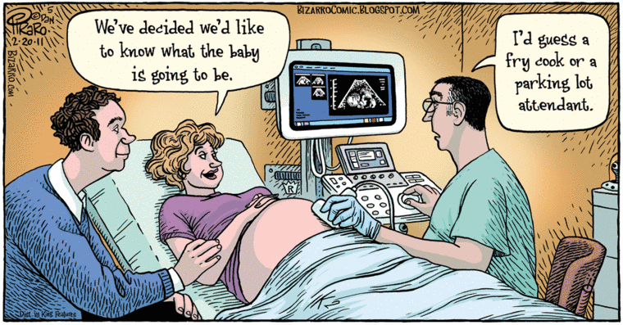
Next steps – Planning & Implementation
Question: How can MCHD and partners further support women, infants, children and families to reach their fullest potential in health and wellbeing?

Slide 21
Data Sources
Birth records, Multnomah County, 1989-2007
Pregnancy Risk Assessment and Monitoring System (PRAMS), 2005-2007
ALERT Immunization Information System, 2005-2009
Data on child abuse and neglect for Multnomah County from Children First for Oregon, www.cffo.org

Slide 22
Bibliography
Peoples-Sheps MD, Byars E, Rogers MM, Finerty EJ, Farel A. Assessment of Health Status Problems. In: Self-Instructional Manual. Chapel Hill, NC: School of Public Health, University of North Carolina at Chapel Hill. 1990, revised 1995, 2001.
Multnomah County Health Department. Strategic Plan FY2010-FY2014. Portland, OR: Multnomah County Health Department; 2009.
Kaan S, Wiggins N, Robinson M, Guernsey-Camargo J, Quirox O. Health Promotion Framework at Multnomah County Health Department. Multnomah County Health Department, Health Promotion Community of Practice; 2009.
Lu M & Halfon N, Racial and Ethnic Disparities in Birth Outcome: A Life-Course Perspective, MCHJ 2003;7:13-30.
Gaudino, JA Jr, Jenkins B, Rochat RW. No father’s names: a risk factor for infant mortality in the State of Georgia, USA. Soc Sci Med. 1999 Jan;48(2):253-65.
Multnomah County Health Department. Strategic Intent for Families and Young Children. Portland, OR: Multnomah County Health Department; 2011.

Slide 23
Thank you!
Jim Gaudino
Multnomah County Health Department
(503) 988-5090 Ext. 27915
james.gaudino@multco.us

